Slide 1
Jacopo Farina

Slide 2
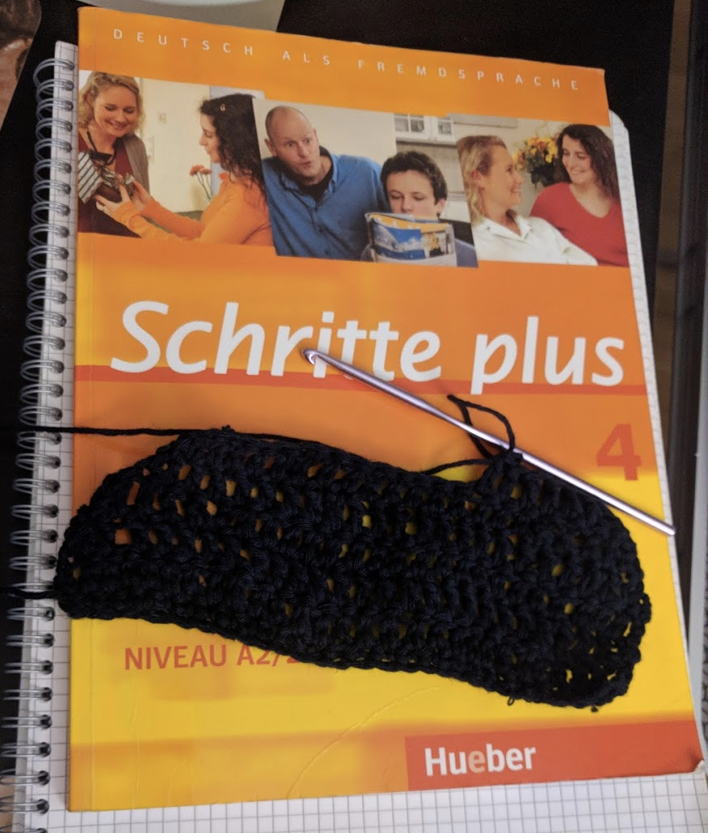
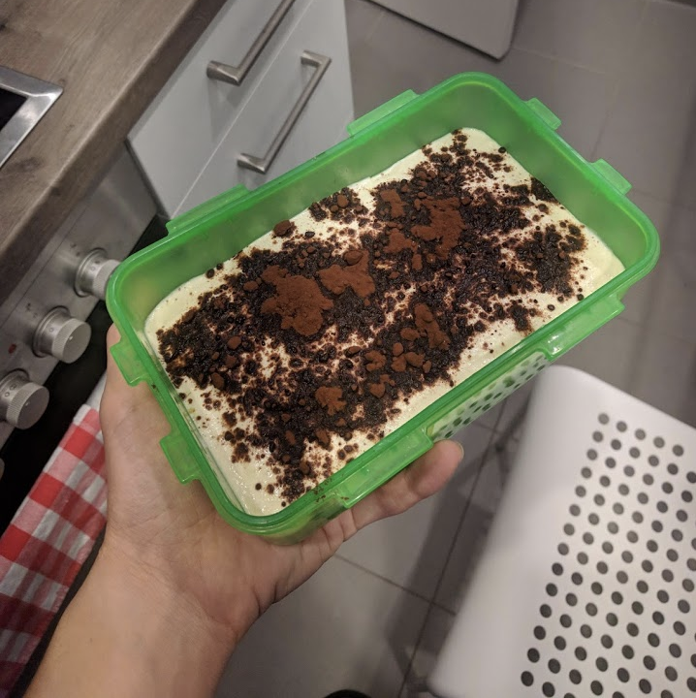
What do I do?
Biking
Slowly learning German
Cooking
Crocheting
Developing (for fun and profit)

Slide 3



How can I help you?
Second semester at ReDI
Second course at ReDI
Intro to Python, spring 2018
Intro to Programming with Python, winter 2018
Software Developer at Flixbus
Python, SQL and Javascript
Experience in SQL and frontend
Much into Natural Language Processing

Slide 4
How can you contact me?
Slack: the easiest way
Email: jacopo1.farina@gmail.com
Github: https://github.com/jacopofar/

